Slide 1
Making this resource work for you
Prior to teaching this lesson, please refer to the ‘Unit Overview and Planning Document’.
Further guidance on planning Science Mastery lessons can be found in the detailed planning guidance document.
Refer to the ‘notes’ section on each slide for useful information, including suggested expositions, pedagogical content knowledge, suggested questions, answers and more. Consider using presenter mode so you can see this guidance throughout the lesson.
The introduction slides can be adapted to suit your teaching style and the needs of your class.
Before the lesson, adapt the fix-it slide to address any misconceptions identified in the previous lesson’s exit ticket.
Choose from the suggested activities to suit your class. The intention is not that you complete all of these, but that you select those which ones are most appropriate for your students. It may be appropriate to further adapt activities for your students.
These lessons are designed to occupy approximately 1 hour. To adapt for a shorter or longer lesson duration we advise you to adapt the activity section accordingly.
Please consider using the final slide to send feedback about this lesson or examples of PowerPoints that you have adapted to our design team. Your feedback is used to improve Science Mastery for all of our teachers and students. We appreciate all suggestions and comments.
Thank you for reading!
The Science Mastery Team

Slide 2
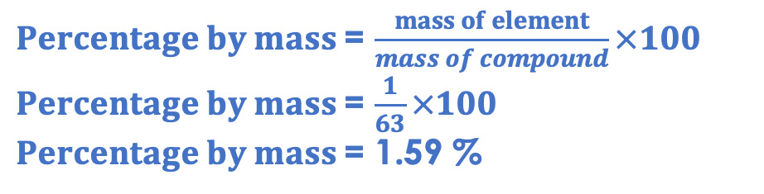
(HT) Strong and Weak Acids
Answer the questions below.
State the chemical formula for hydrochloric acid.
State the chemical formula for sulfuric acid.
State the pH range of acids.
Calculate the relative formula mass of nitric acid (HNO₃).
Calculate the percentage by mass of hydrogen in nitric acid.
HCl
H₂SO₄
Less than 7
1+14+(3x16) = 63
$Percentage by mass$= $\frac{mass of element}{mass of compound}×100$
$Percentage by mass$= $\frac{1}{63}×100$
$Percentage by mass$= 1.59 %
Notes:
Big idea: Reactions rearrange matter
Foundation: Name the type of salt produced by hydrochloric acid.
Stretch: Write a balanced symbol equation for the reaction between sulfuric acid and sodium hydroxide.
Answers:
Foundation: Chlorides
Stretch: H₂SO₄ + 2NaOH → Na₂SO₄ + 2H₂O

Slide 3
(HT) Strong and Weak Acids
Do Now:
State the chemical formula for hydrochloric acid.
State the chemical formula for sulfuric acid.
State the pH range of acids.
Calculate the relative formula mass of nitric acid (HNO₃).
Calculate the percentage by mass of hydrogen in nitric acid.
Drill:
Name the salt that would be produced in a reaction between hydrochloric acid and copper oxide.
Name the salt that would be produced in a reaction between nitric acid and calcium hydroxide.
Name the salt that would be produced in a reaction between sulfuric acid and lithium carbonate.
Notes:
Drill answers:
copper chloride
calcium nitrate
lithium sulfate

Slide 4
(HT) Strong and Weak Acids
Read Now:
When a solute dissolves in a solvent, a solution is formed. Acids in solution are another example of a solute being dissolved in a solvent. The concentration of the solution is a measure of how much solute is present per unit volume. A concentrated solution has lots of solute per unit volume and a dilute solution has much less solute per unit volume. The concentration of an acid affects its pH, but pH is also affected by the strength of an acid. A strong acid, such as hydrochloric acid, is one which fully dissociates into ions solution. This means that in solution, it splits completely into H⁺ and Cl⁻ ions. A weak acid, such as ethanoic acid, is one which does not fully dissociate into ions in solution.
Define a solution.
Explain the difference between a concentrated and a dilute solution.
Explain what is meant by a strong acid.
Give an example of a strong acid.
Explain what is meant by a weak acid.
Give an example of a weak acid.

Slide 5
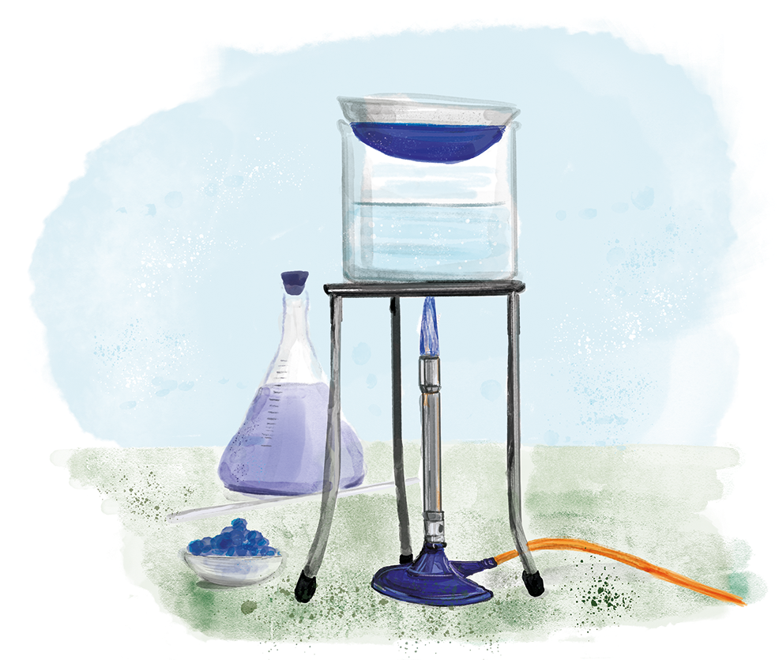
C4.3.14
03/02/2025
(HT) Strong and Weak Acids
C4.3.1 Prior Knowledge Review
C4.3.2 (HT) Introducing the Mole
C4.3.3 (HT) Mole Calculations
C4.3.4 PKR: Concentration
C4.3.5 TIF: Calculating Concentration
C4.3.6 TIF: Calculating an Unknown Concentration
C4.3.7 (HT) Amounts of Substances in Equations
C4.3.8 (HT) Limiting Reactants
C4.3.9 PKR: Reactions of Acids
C4.3.10 Acids, Alkalis and Neutralisation
C4.3.11 TIF: Acid-Alkali Titration
C4.3.12 TIF: Acid-Alkali Titration Analysis
C4.3.13 TIF: Titration Calculations
C4.3.14 (HT) Strong and Weak Acids
C4.3.15 TIF: Volumes of Gases
Notes:
Big idea: Reactions rearrange matter
In this lesson, students will build on their knowledge of acid reactions and neutralisation, as well as their understanding of the meaning of concentration to look at the difference between strong and weak and concentrated and dilute and understand how each affect the pH of an acid.
Suggested Hook:
What does it mean for an acid to be highly acidic? What would the pH of a highly acidic acid be?

Slide 6

Following this lesson, students will be able to:
Explain the difference between a strong acid and weak acid
Explain the factors that affect pH of an acid
Explain the difference between strength and concentration
Key Words:
acid
strong
weak
concentrated
dilute
ionise
dissociate
Notes:
Guidance:
See unit overview document and planning guidance to see how these objectives are typically assessed at GCSE, including examples of what students should be able to do following this lesson.
Planning for different needs:
The learning objectives given on this slide are suggested based on the most common requirements for exams, however they can be adapted based on the needs of different classes.
For best practice, the unit preparation booklet should be used to determine the appropriate focus of lessons within the unit.
While it is not possible to explicitly split content into levelled grades, we recommend that lesson objectives can be classified as critical, core or stretch.
Critical: the content or skill is essential for all students to be able to progress.
Core: the content or skill is important for students to progress, but other opportunities may be available to revisit it.
Stretch: the content or skill may not be essential for all students but is important for students aiming for the highest grades.
Key skill: this is a crucial skill being developed in this unit as part of the skill mapping
C4.3.14 Lesson Objectives:
Critical: Explain the difference between a strong acid and weak acid
Core: Explain the factors that affect pH of an acid
Critical: Explain the difference between strength and concentration

Slide 7
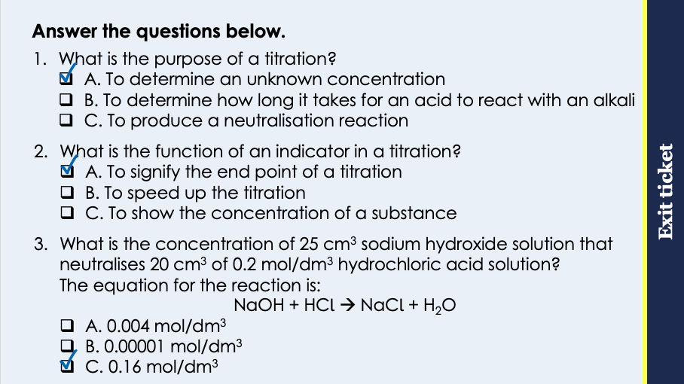
This is the fix-it portion of the lesson
The fix-it is an opportunity to respond to gaps in knowledge, especially those identified by the pre-unit quiz.
The teacher should customise this slide as needed, to facilitate
reteach, explanation, demonstration or modelling of ideas and concepts that students have not yet grasped or have misunderstood.
practise answering specific questions or of key skills.
redrafting or improving previous work.
Notes:
Purpose: to spend time on any gaps identified in previous learning from exit ticket.
Fix-it guidance from previous exit ticket:
Q1. Answer: A
If students answer B or C, they are not clear on the function of a titration. To fix it, explain the purpose and give students some examples of where titrations may be useful in real life, such as determining concentration of acids in foods or concentration of pollutants in water samples.
Q2. Answer: A
If students answer B or C, they have not recognised function of the indicator. To fix it, review the function of the indicator and explain why phenolphthalein would be used rather than Universal indicator.
Q3. Answer: C
If students answer A, they have taken the number of moles of the hydrochloric acid and missed the final two steps. If students answer B, they have used the 1:1 mole ratio but have multiplied number of moles by volumes. To fix it, model how to lay out and solve this question and give students further practice.

Slide 8
pH
Higher Tier only
What is pH actually a measure of?
pH denotes ‘potential of hydrogen’ so is a measure of the hydrogen ion concentration in a solution.
All acids produce hydrogen ions (H⁺) in aqueous solutions.
pH of an acid is affected by:
Concentration of an acid
Strength of an acid
Notes:
Suggested exposition:
We’ve been looking at pH since acids and alkalis and we know that acids have a pH of less than 7 (1-6), neutral substances have a pH of 7 and alkalis have a pH of greater than 7 (8-14). We also know that we can measure pH using universal indicator or a pH probe and we can tell whether something is acidic or alkaline using litmus paper. But what actually is pH? What does it measure?
The term ‘pH’ actually denotes ‘potential of hydrogen’ and it is a measure of the concentration of hydrogen ions per unit volume (moles of hydrogen ions per dm³).
So where do these hydrogen ions come from?
All acids produce hydrogen (H+) ions when in aqueous solutions. Aqueous just means a solution where the solvent is water (from aqua!).
There are two factors that affect the pH of an acid:
the concentration of the acid
the strength of the acid
Lots of people assume these mean the same thing, which is usually because in normal life we use the terms interchangeably, like if you were making a glass of ribena. You would say ‘make mine strong’ when actually what you mean is ‘make mine concentrated’. Concentration is a measure of the number of molecules (in this case acid molecules) per unit volume. If we have a high concentration of acid molecules, there will be lots of molecules able to produce hydrogen ions in solution, so the concentration of hydrogen ions will be high and therefore the pH will be low. Remember the lower the pH, the greater the hydrogen ion concentration.
But this relationship is not a linear one…

Slide 9
pH and Concentration
Higher concentration of acid molecules
Greater concentration of hydrogen (H⁺) ions
Lower pH
High concentration
Low concentration
Notes:
Suggested exposition:
Remember these diagrams? The yellow circles represent the particles of solute. In this case, they are the acid particles dissolved in solution. The greater the concentration of acid molecules, the more hydrogen ions will be able to be produced, as all acids produce hydrogen ions in solution. This means that there will be a greater concentration of H+ ions in a more concentrated acid, so a more concentrated acid will have a lower pH.
Consider 1 mol/dm³ of hydrochloric acid vs 0.1 mol/dm³ of hydrochloric acid. The 1 mol/dm³ solution has 10 times as many acid molecules in the given volume than the 0.1 mol/dm³.
We can change the concentration of an acid by adding or removing solute (acid) or solvent (water). The word dilute can either mean the opposite of concentrated (as a noun) or to dilute (as a verb) meaning to add more solvent.

Slide 10
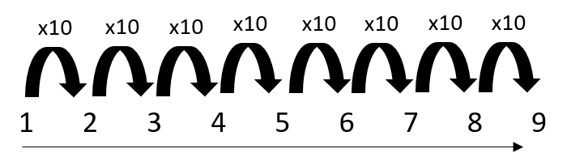
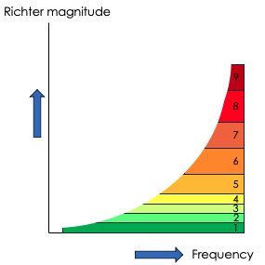
Unusual scales
Scientists describe the magnitude (strength) of an earthquake using the Richter Scale.
This scale of numbers is unusual because an earthquake that measures 2 on the scale is not double the magnitude of an earthquake measuring 1.
It is 10 times the magnitude.
Increasing magnitude of earthquake
Notes:
Suggested exposition:
The pH scale is an unusual scale. The scale that we usually use are linear scales, for example, the scale for Hooke’s Law in P1.1 where if the force is doubled the spring the extension would also double. However, in the case of pH if I decrease the pH by 1 the acidiity increases by a factor of 10. This is similar to the Richter scale used to measure earthquake. The Richter scale is an exponential scale which uses powers of 10 to compare the magnitude or size of earthquakes. This scale of numbers is unusual because instead of an earthquake that measures 2 on the scale being double the magnitude of an earthquake measuring 1, an earthquake that measures 2 on the scale is 10 x as great as an earthquake that measures 1.
Note:
The pH scale is not a linear scale. Each time you go up the pH scale, the scale goes up by 10x. The linear nature of the pH scale should be taught by drawing the diagram on the board and explaining it through the understanding of the Richter Scale. Putting the linear nature of the pH scale in the context of the Richter Scale may allow for easier understanding (this is KS2 content). If not, then show this video: https://www.youtube.com/watch?v=NaNw9LHq9dc or https://www.youtube.com/watch?v=u-QbqGB1Ooc for lower attaining classes.
Image source:
Richter Scale: https://i.ytimg.com/vi/_q_2VdqiKbw/maxresdefault.jpg

Slide 11
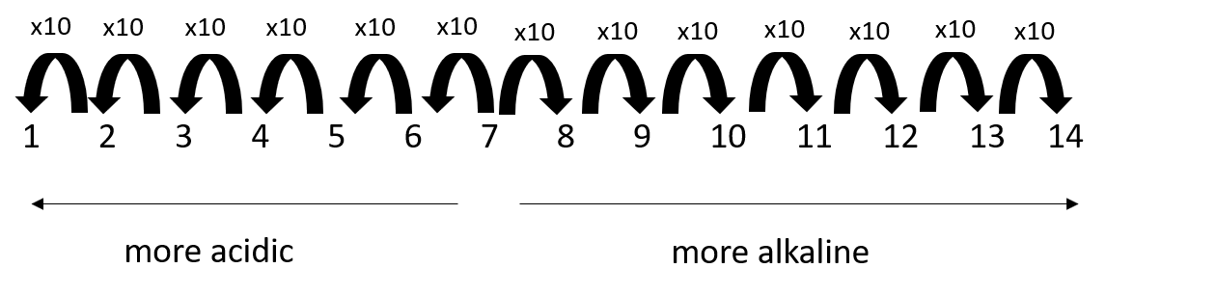
Unusual scales
Magnitude of pH is also described in the same way:
How does the acidity of Solution A (pH 4) and B (pH 5) compare?
Solution A is 10x more acidic than solution B
Notes:
Suggested exposition:
We saw on the previous slide that the pH scale also has an unusual scale. For example, it I were to compare solution of pH 10 and pH 11, I can say that pH 11 solution is 10x more alkaline compared to solution of pH 10.
How does the acidity of Solution A (pH 4) and B (pH 5) compare?
Solution A is 10x more acidic than solution B.
So what does this mean in terms of our hydrogen ion concentration, seeing as pH is a measure of hydrogen ion concentration?
If the pH decreases by 1 pH point, the concentration of hydrogen ions increases by a factor of 10.
So let’s think about our 1 mol/dm3 and 0.1 mol/dm3 hydrochloric acid samples again. If I decrease the concentration from 1 mol/dm3 to 0.1 mol/dm3 I have decreased the concentration by a factor of 10. This is equivalent to 1 point on the pH scale. So if my 1 mol/dm3 solution had a pH of 3, my 0.1 mol/dm3 solution will have a pH of 4.
What will happen to the pH if I make the concentration 0.01 mol/dm3?
The concentration of acid (and therefore of hydrogen ions that would be produced) has decreased by another factor of 10. This would increase the pH to pH 5.

Slide 12
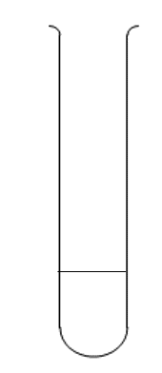
Comparing pH
How does the hydrogen ion concentration of Solution X and Y compare?
Y has twice the hydrogen ion concentration of X
Y has 10 times the hydrogen ion concentration of X
X has 10 times the hydrogen ion concentration of Y
How does the hydrogen ion concentration of Solution X and Z compare?
X has 1000 times the hydrogen ion concentration of Z
Z has 1000 times the hydrogen ion concentration of X
X has three times the hydrogen ion concentration of Z
How does the hydrogen ion concentration of Solution Y compare with Z?
Y has four times the hydrogen ion concentration of Z
Z has 10 000 times the hydrogen ion concentration of Y
Y has 10 000 times the hydrogen ion concentration Z
solution X
pH 2
solution Y
pH 1
solution Z
pH 5
Notes:
Guidance: MWB or 1,2,3 finger CFU

Slide 13
pH and Strength
Higher Tier only
A strong acid is one which fully dissociates in solution.
This means that it breaks up into its ions, including hydrogen ions.
Strong acids are:
Hydrochloric acid
Sulfuric acid
Nitric acid
We can represent what happens to strong acids in solutions:
HCl (aq) → H⁺ (aq) + Cl⁻ (aq)
Notes:
Suggested exposition:
So what is strength then? And why is it not the same as concentration?
Acids can be described as either strong or weak. Concentration can change, but whether an acid is strong or weak cannot change.
A strong acid is one which fully dissociates or ionises in solution. This means that it breaks up completely into its ions. Remember that all acids produce hydrogen ions in solution, so a strong acid is one in which all the acid molecules separate into their ions.
Hydrochloric acid, sulfuric acid and nitric acid are all strong acids.
We can represent what happens to them in solutions like this: dissociation equation.
Strong acids therefore produce lots of hydrogen ions in solution, so a stronger acid will have a lower pH than a weaker acid of the same concentration.

Slide 14
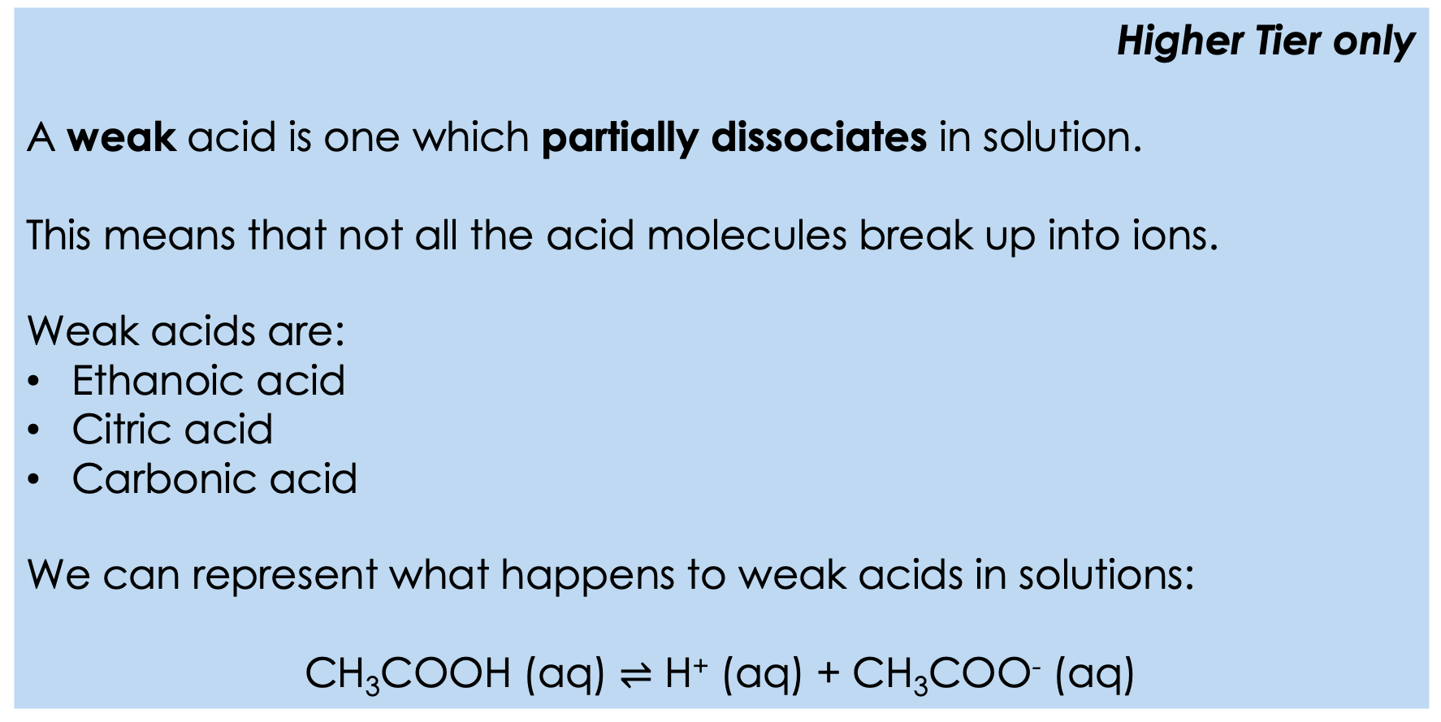
Weak Acids
Higher Tier only
A weak acid is one which partially dissociates in solution.
This means that not all the acid molecules break up into ions.
Weak acids are:
Ethanoic acid
Citric acid
Carbonic acid
We can represent what happens to weak acids in solutions:
CH₃COOH (aq) $⇌$ H⁺ (aq) + CH₃COO⁻ (aq)
Notes:
Suggested exposition:
A weak acid is one which does not fully dissociate in solution. We can say they partially dissociate in solution. This means that some molecules of acid break up into the ions, but some molecules stay as acid molecules without breaking up.
Ethanoic acid, citric acid and carbonic acid are examples of weak acids. We can represent what happens to weak acids in solution: dissociation equation.
This symbol is the symbol for a reversible reaction (which we will meet again in C5.1). This symbol is used to show that the reaction does not go to completion: not all the acid molecules break up or dissociate into ions.
You may also see and hear the word ionise used instead of dissociate. They mean the same thing: if something ionises, it forms ions.
This means that weak acids will have higher pHs (less acidic) than strong acids, if they have the same concentration, because they will produce a lower concentration of hydrogen ions in solution.

Slide 15
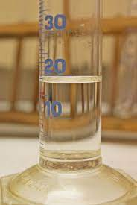
H⁺ ions and concentration
A sample of hydrochloric acid solution has a concentration of 1 x 10⁻³ mol/dm³.
The sample has a pH of 2.
Is hydrochloric acid a strong acid or a weak acid?
A strong acid. It fully dissociates into H⁺ and Cl⁻ ions in solution.
If the sample is diluted to a concentration of 1 x10⁻⁵ mol/dm³, what happens to its pH?
The concentration of H+ ions decreases by a factor of 100.
This means it has decreased by a factor of 10, then another factor of 10.
For each factor of 10 decrease, pH increases by 1 unit.
The new sample has increased by 2 pH units, so the new pH is pH 4.
How would the sample have been diluted?
By adding more solvent, so there is a smaller amount of solute per unit volume.
Notes:
Image source:
https://commons.wikimedia.org/wiki/File:Hydrochloric_acid_30-33%25_by_Danny_S._-_001.jpg

Slide 16

Is this correct?
If they have the same concentration, hydrochloric acid will have a higher pH than ethanoic acid.
Notes:
This is a common misconception where students confuse high/low pH.
If they have the same concentration, the hydrochloric acid is a strong acid so will have a lower pH than ethanoic acid.
Suggested guidance:
Talk tasks can be used in a variety of ways to suit the particular needs of the students you are teaching. Through exchanging views with others, students develop their understanding of the science beyond what could be achieved individually.
Science classrooms that successfully integrate talk have the following features:
Science talk is a regular feature of lessons and is woven into classroom activities.
Students are paired or grouped strategically by the teacher to ensure productive interaction. This might take into consideration the students’ proficiency of the English language, how encouraging they might be to peers and their attainment in the topic. It’s a good idea to consider these pairings in the class seating plan.
Students are encouraged and supported to talk, but are not forced to talk.
The teacher should take on the role of a facilitator, engaging with conversations where necessary and encouraging or steering the conversation where needed.
Students are encouraged to use the language they have to express their ideas (e.g., everyday language, imperfect English, native language), but also to incorporate science specific terminology where this is more accurate or has been taught.
6. Scientifically inaccurate ideas are not dismissed by the partner or teacher; open discussion and further investigation are relied on to help students construct ideas that support them to progress in their scientific understanding.
7. Guidelines for behaviour during talk tasks are explicit and frequently reviewed. Rules for students might be:
Listen carefully to your partner
Take turns talking.
Speak one at a time, without interrupting.
Politely agree or disagree and explain why.
Politely point out if your partner has used a scientific word incorrectly, if they have explained the science incorrectly, or if there is a more accurate way to describe something.
If confused, ask questions.
Stay focused on the discussion topic.
Respond to one another.

Slide 17

Can you explain the difference between these two terms?
A strong acid
A concentrated acid
Notes:
Suggested points:
Strength and concentration both affect the pH of an acid, but they do not mean the same thing.
A strong acid is one which dissociates fully in solution.
A concentrated acid is a solution that contains a relatively large quantity of acid particles per unit volume.
Suggested guidance:
Talk tasks can be used in a variety of ways to suit the particular needs of the students you are teaching. Through exchanging views with others, students develop their understanding of the science beyond what could be achieved individually.
Science classrooms that successfully integrate talk have the following features:
Science talk is a regular feature of lessons and is woven into classroom activities.
Students are paired or grouped strategically by the teacher to ensure productive interaction. This might take into consideration the students’ proficiency of the English language, how encouraging they might be to peers and their attainment in the topic. It’s a good idea to consider these pairings in the class seating plan.
Students are encouraged and supported to talk, but are not forced to talk.
The teacher should take on the role of a facilitator, engaging with conversations where necessary and encouraging or steering the conversation where needed.
Students are encouraged to use the language they have to express their ideas (e.g., everyday language, imperfect English, native language), but also to incorporate science specific terminology where this is more accurate or has been taught.
6. Scientifically inaccurate ideas are not dismissed by the partner or teacher; open discussion and further investigation are relied on to help students construct ideas that support them to progress in their scientific understanding.
7. Guidelines for behaviour during talk tasks are explicit and frequently reviewed. Rules for students might be:
Listen carefully to your partner
Take turns talking.
Speak one at a time, without interrupting.
Politely agree or disagree and explain why.
Politely point out if your partner has used a scientific word incorrectly, if they have explained the science incorrectly, or if there is a more accurate way to describe something.
If confused, ask questions.
Stay focused on the discussion topic.
Respond to one another.

Slide 18


True or false?
False
A strong acid has a high pH
A strong acid dissociates fully in solution
Ethanoic acid is a strong acid
Concentration does not affect pH
If two acids have the same concentration, the stronger acid will have a lower pH
True
False
False
True
Notes:
Purpose: to check that key knowledge from the introduce phase has been learnt and understood.
You may wish to provide students with white boards to enable them to carry out calculations.
1F; 2T; 3F; 4F; 5T;

Slide 19
Explaining pH difference
A scientist has two samples of acids:
2 mol/dm³ hydrochloric acid
1 mol/dm³ ethanoic acid
Which is the stronger acid?
Hydrochloric acid. Ethanoic acid is a weak acid.
Which is the more concentrated acid?
Hydrochloric acid. It has a greater amount of solute (number of moles) per unit volume.
Which would have the lower pH?
Hydrochloric acid. It is the stronger acid and is more concentrated, so the concentration of H⁺ ions in solution will be much greater.

Slide 20
Drill
Define a strong acid.
Give an example of a strong acid.
Define a weak acid.
Give an example of a weak acid.
State the pH range of acids.
Name the ion found in all acids.
Explain what it means for an acid to dissociate.
Notes:
Purpose: This is a knowledge drill. The purpose of this is to check that the critical knowledge is secure before pupils move onto independent practice.
Suggested guidance: There are a range of ways this could be done depending on time and ability range of the class:
Mini whiteboards
As full sentences in exercise books
As short answers in exercise books
In the pupil workbook
As pair talk
As cold call

Slide 21
Drill answers
An acid that completely dissociates into ions in solution.
Hydrochloric acid, nitric acid, sulfuric acid
An acid that does not completely dissociate into ions in solution.
Ethanoic acid.
Less than 7 (1-6)
H⁺
The acid breaks up into its ions.
Notes:
Purpose: This is a knowledge drill. The purpose of this is to check that the critical knowledge is secure before pupils move onto independent practice.
Suggested guidance: There are a range of ways this could be done depending on time and ability range of the class:
Mini whiteboards
As full sentences in exercise books
As short answers in exercise books
In the pupil workbook
As pair talk
As cold call

Slide 22

I: Explain: to use scientific understanding to make something clear or state the reason for something happening
Example question:
To ‘explain’ your answer should:
Begin with a scientific statement.
Use ‘this means that’, ‘because’ or ‘so’ to link your statement to the question.
Explain how it is possible for ethanoic acid to be weak and concentrated.
Model answer:
Strength refers to the dissociation of the acid into ions, so the ethanoic acid only partially dissociates as it is a weak acid
Concentrated means that there are lots of acid molecules in a given volume of solution, so there is a high concentration of H⁺ ions
Notes:
This slide models the process of answering an explain question.
Firstly, students are presented with a generic explain question, along with a model answer. Students are also given some simple guidance to follow for producing their own describe answer.
The generic question and answer should be used by the teacher to remind students of
the key features of a great answer
how to structure their answer
why the model answer is a good example
Following this, students will be required to apply this process to answer their own explain question, which will appear in place of the generic questions. This explain question will be specific to the topic students are learning about in the lesson. Give students time to write their own answer to this, ensuring that they use the guidance provided. To further scaffold this task for students, it may be appropriate to:
pair students up to write an answer together
list for students the key words you would like them to include in the answer
provide a writing frame or ‘points to include’ for students
A model answer for this question will appear. Teachers should review the model answer with students by referencing the guidance in the green box. For example ‘we can see item 1 in the guidance is to begin with a scientific statement. Notice in the model answer here we have done just that’. Or ‘item 2 in the guidance here says that we should use a linking statement in the answer. Has this been achieved in the model answer? Where can we see this?’.

Slide 23
We: Explain: to use scientific understanding to make something clear or state the reason for something happening
Example question:
To ‘explain’ your answer should:
Begin with a scientific statement.
Use ‘this means that’, ‘because’ or ‘so’ to link your statement to the question.
Explain how it is possible for sulfuric acid to be strong and dilute.
Model answer:
Strength refers to the dissociation of the acid into ions, so the sulfuric acid dissociates fully as it is a strong acid
Dilute means that there are relatively few acid molecules in a given volume of solution, so there is a low concentration of H⁺ ions
Notes:
This slide models the process of answering an explain question.
Firstly, students are presented with a generic explain question, along with a model answer. Students are also given some simple guidance to follow for producing their own describe answer.
The generic question and answer should be used by the teacher to remind students of
the key features of a great answer
how to structure their answer
why the model answer is a good example
Following this, students will be required to apply this process to answer their own explain question, which will appear in place of the generic questions. This explain question will be specific to the topic students are learning about in the lesson. Give students time to write their own answer to this, ensuring that they use the guidance provided. To further scaffold this task for students, it may be appropriate to:
pair students up to write an answer together
list for students the key words you would like them to include in the answer
provide a writing frame or ‘points to include’ for students
A model answer for this question will appear. Teachers should review the model answer with students by referencing the guidance in the green box. For example ‘we can see item 1 in the guidance is to begin with a scientific statement. Notice in the model answer here we have done just that’. Or ‘item 2 in the guidance here says that we should use a linking statement in the answer. Has this been achieved in the model answer? Where can we see this?’.

Slide 24
You: Explain: to use scientific understanding to make something clear or state the reason for something happening
Example question:
To ‘explain’ your answer should:
Begin with a scientific statement.
Use ‘this means that’, ‘because’ or ‘so’ to link your statement to the question.
Explain the factors that affect the pH of an acid.
Model answer:
pH is a measure of the concentration of H⁺ ions in a solution
Acids produce H⁺ ions in solution
A concentrated solution contains many acid molecules per unit volume, so the more concentrated an acid, the more H⁺ ions present and the lower the pH
A strong acid fully dissociates in solution, so the stronger an acid, the more H⁺ ions present and the lower the pH
Notes:
This slide models the process of answering an explain question.
Firstly, students are presented with a generic explain question, along with a model answer. Students are also given some simple guidance to follow for producing their own describe answer.
The generic question and answer should be used by the teacher to remind students of
the key features of a great answer
how to structure their answer
why the model answer is a good example
Following this, students will be required to apply this process to answer their own explain question, which will appear in place of the generic questions. This explain question will be specific to the topic students are learning about in the lesson. Give students time to write their own answer to this, ensuring that they use the guidance provided. To further scaffold this task for students, it may be appropriate to:
pair students up to write an answer together
list for students the key words you would like them to include in the answer
provide a writing frame or ‘points to include’ for students
A model answer for this question will appear. Teachers should review the model answer with students by referencing the guidance in the green box. For example ‘we can see item 1 in the guidance is to begin with a scientific statement. Notice in the model answer here we have done just that’. Or ‘item 2 in the guidance here says that we should use a linking statement in the answer. Has this been achieved in the model answer? Where can we see this?’.

Slide 25
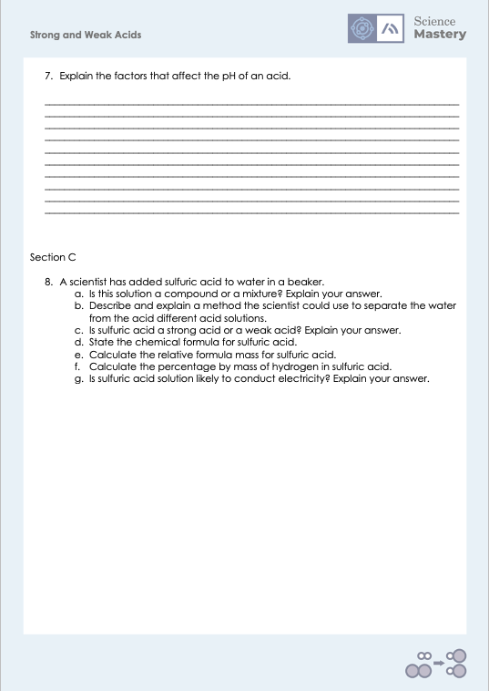
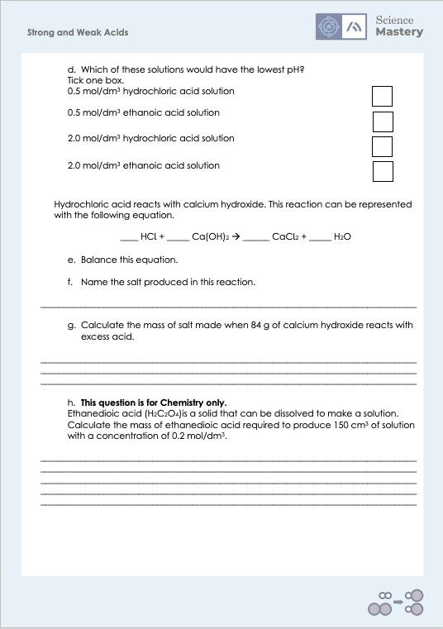
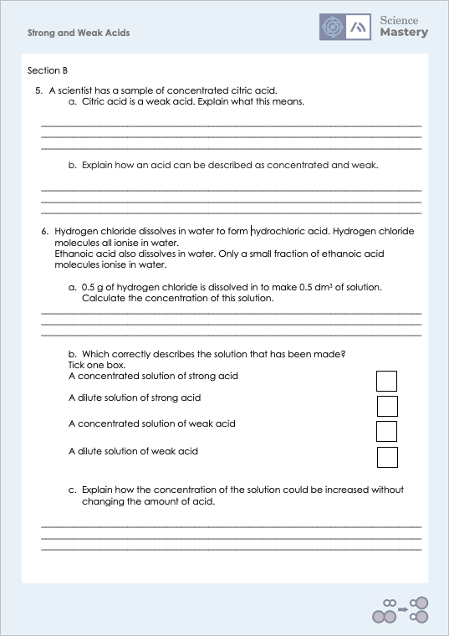
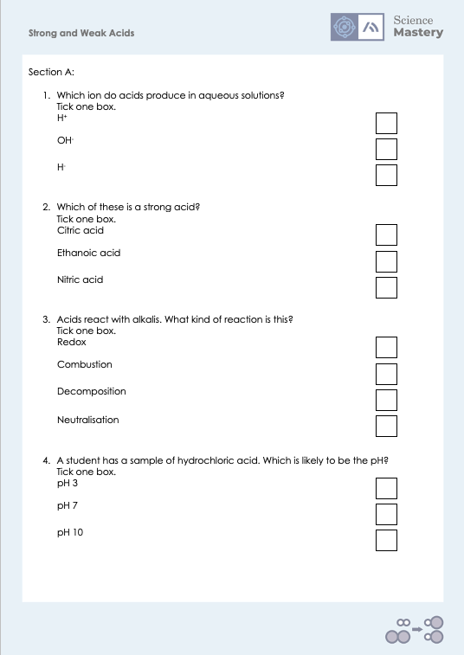
Activity

Slide 26
Answers
1. H⁺
2. Nitric acid
3. Neutralisation
4. pH 3
5a. It produces hydrogen/H+ ions in solution but only partially ionises/dissociates
5b. It only partially ionises/dissociates but contains a relatively large amount of acid molecules per unit volume (of solvent).

Slide 27
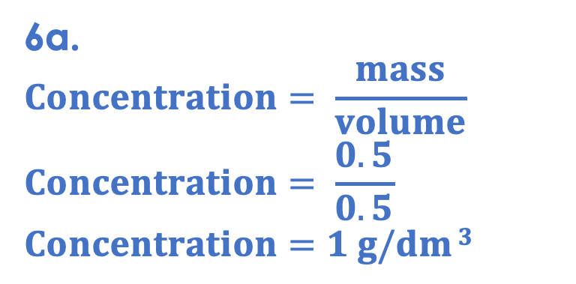
Answers
6a.
$$Concentration= \frac{mass}{volume}$$
$$Concentration= \frac{0.5}{0.5}$$
$$Concentration=1 g/dm 3$$
6b. A dilute solution of strong acid
6c. Concentration is the mass (or amount) of solute per unit volume of solvent. Decreasing the volume of solvent would increase the concentration. This could be done by evaporation (or distillation) or the solvent.
6d. 2.0 mol/dm³ hydrochloric acid solution

Slide 28
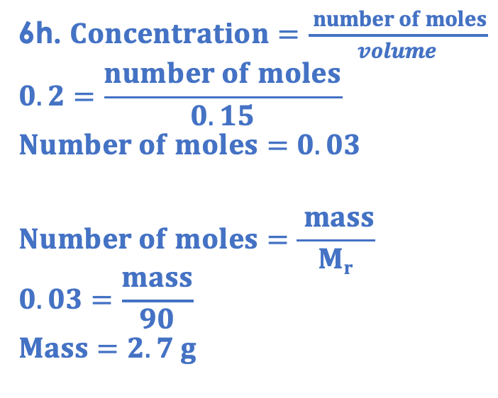
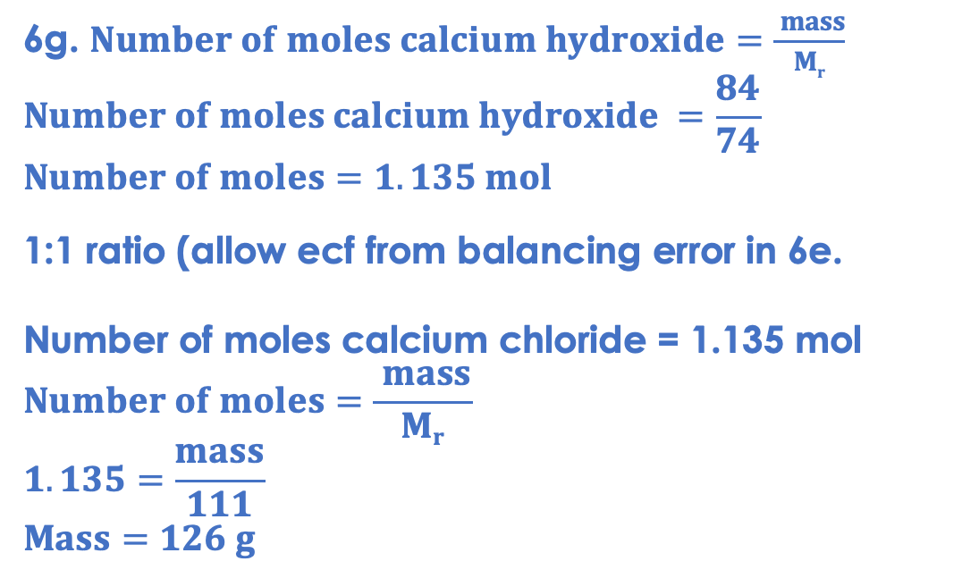
Answers
6e. 2 HCl + Ca(OH)₂ → CaCl₂ + 2 H₂O
6f. calcium chloride
6h. $Concentration=\frac{ number of moles}{volume}$
$$0.2=\frac{number of moles}{0.15}$$
$$Number of moles=0.03$$
$$Number of moles=\frac{ mass}{Mr}$$
$$0.03=\frac{mass}{90}$$
$$Mass=2.7 g$$
6g. $Number of moles calcium hydroxide=\frac{ mass}{Mr}$
$$Number of moles calcium hydroxide =\frac{84}{74}$$
$$Number of moles=1.135 mol$$
1:1 ratio (allow ecf from balancing error in 6e.
Number of moles calcium chloride = 1.135 mol
$$Number of moles=\frac{ mass}{Mr}$$
$$1.135=\frac{mass}{111}$$
$$Mass=126 g$$

Slide 29
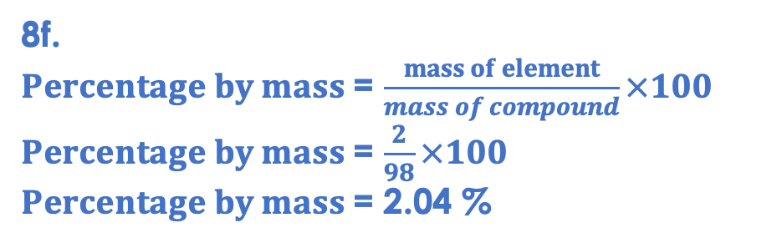
Answers
8a. A mixture. The sulfuric acid is not chemically bonded to the water.
8b. Different substances have different boiling points, so evaporation or distillation could be used to separate them. The substance with the lower boiling point will evaporate first.
8c. A strong acid. It fully dissociates in solution.
8d. H₂SO₄
8g. Yes. It fully dissociates into ions in solution, so the ions are free to move through solution and carry charge.
8e. (2x1)+32+(4x16) = 98
8f.
$Percentage by mass$= $\frac{mass of element}{mass of compound}×100$
$Percentage by mass$= $\frac{2}{98}×100$
$Percentage by mass$= 2.04 %

Slide 30
Answer the questions below.
What is a strong acid?
A. An acid that contains lots of solute per unit volume
B. An acid that has lots of H+ ions
C. An acid that fully dissociates in solution
✓
Which of these is not a strong acid?
A. Hydrochloric acid
B. Sulfuric acid
C. Ethanoic acid
✓
Which of these will have the lowest pH?
A. 1 mol/dm³ ethanoic acid
B. 1 mol/dm³ hydrochloric acid
C. 2 mol/dm³ hydrochloric acid
✓
Notes:
Q1. Answer: C
If students answer A, it suggests they have confused strength and concentration. To fix it, get students to define each. If students answer B, they have recognised that there is a relationship between strength and H+ ions, but this is not specific enough as it could also refer to concentration. To fix it, get students to define strong and weak acids and explain the two factors that affect the pH of an acid.
Q2. Answer: C
If students answer A or B, they have not recognised the strong and weak acids. To fix it, review the definitions and examples of each.
Q3. Answer: C
If students answer A, they have confused the lowest pH with the highest pH, assuming that lowest is ‘the least/lowest acidity’ rather than lowest pH. If students answer B, they have not recognised the relationship between concentration and pH. To fix it, get students to explain the two factors that affect the pH of an acid.

Slide 31
Lesson C4.3.14
What was good about this lesson? | What can we do to improve this lesson?
Send us your feedback by clicking this link
or by emailing sciencemastery@arkonline.org
Thank you!

